Slide 1
Graphs - Algorithms and Mining (DSE** ZG521)

Slide 2
Module II

Slide 3
Plan of Lecture
2. Static Graphs
  2.1. Degree distribution, Power Laws,
  2.2. Diameter
  2.3. Connected components
  2.4. Eigen-spokes
  2.5. Scalability
  2.6 Keyword Search

Slide 4
Dynamics of Graphs
Graphs which arise in many large scale applications such as the web and social networks satisfy many properties such as
  Degree Distribution
  The power law distribution
  Sparsity, and Small Diameters
  Densification, and Shrinking Diameters

Slide 5

Why to study Structure of graphs
What does the web look like?
How about a social network, like LinkedIn or Facebook?
Is it normal for a person to have 500 “friends?”
Is it normal to contact all 500 with equal frequency?
Which are the most important nodes in a graph?
So the main task is to identify:
  What normal is (no proper definition)?
    Based on that we can spot anomalies (strange/abnormal behaviour) !
    Informally, “normal” behaviour is the pattern that the majority follows, and “abnormal” behaviour is the deviation.
  How to define importance?
    ??
NO

Slide 6
Why to study Structure of graphs
The graph encompasses a large number of applications:
Social networks
  Facebook and LinkedIn
    Who-Calls-Whom in a phone network,
    Who-Texts-Whom, or
    Who-Collaborates with Whom.
Cyber-security (for computer networks)
  The goals are to spot strange behaviours, like botnets, port-scanners, exfiltrators
Web and Ranking
  Accelerate or control information/ rumours flow.
influence propagation
e-commerce
  Amazon, Netflix, Ebay, (rating recommendation, ...
….

Slide 7
several reasons to study patterns and laws in real graphs:
Understanding human (machine, protein) behaviour:
  Discovering patterns of connectivity to develop domain expertise
Anomaly detection:
  Extremely short/long diameter wrt six degree of connectivity would be suspicious
Extrapolations:
  Prediction or Forecasting
Generator design:
  Real graphs often have privacy issues and/or high monetary value, and cannot be released

Slide 8
several reasons to study patterns and laws in real graphs:
Graph Compression:
  Web-crawls/Facebook with billions of pages/active users”
    While writing, keeping (and compressing) historical data is important.
  Older mails in your mailbox

Slide 9
Distance, Degree Distribution, Radius & Diameter

Slide 10

Distance between two vertices
Distance is a metric space:
$$d:V×V→Z^{+}∪\left\{0\right\}$$
d(u,v)>= 0 and d(u,v) = 0 iff u=v;
d(u,v) = d(v,u)
d(u,w) + d(w,v) >=d(u,v)
I
A
G
B
H
C
F
J
D
E

Slide 11
Degree Distribution
Degree Distribution
Eccentricity,
Diameter &
Radius Solution.xlsx
I
A
G
B
H
C
F
J
D
E

Slide 12
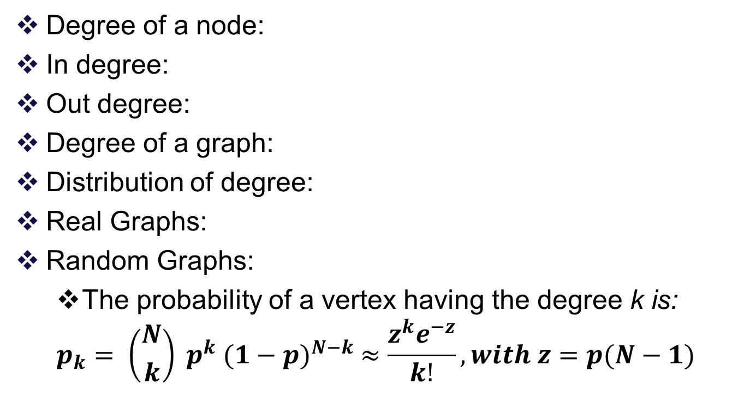
Degree Distribution
Degree of a node:
In degree:
Out degree:
Degree of a graph:
Distribution of degree:
Real Graphs:
Random Graphs:
  The probability of a vertex having the degree k is:
  $$p_{k}= \left({N \atop k}\right) p^{k} {(1−p)}^{N−k} ≈\frac{z^{k}e^{−z}}{k!}, with z=p(N−1)$$

Slide 13
DIAMETER
Diameter (for static graph):
  The maximum distance between any two nodes, where distance is the minimum number of hops (i.e., edges that must be traversed) on the path from one node to another, usually ignoring directionality.
  One liner “maximum-length shortest path between all possible pairs”
  Intuitively, the diameter represents how much of a “small world” the graph is – how quickly one can get from one “end” of the graph to another.
*ANF [1]: works O((N + E)d) time and O(N) space
[1] Christopher Palmer, Phil B. Gibbons, and Christos Faloutsos. ANF: A fast and scalable tool for data mining in massive graphs. 2002. ACM Press.

Slide 14
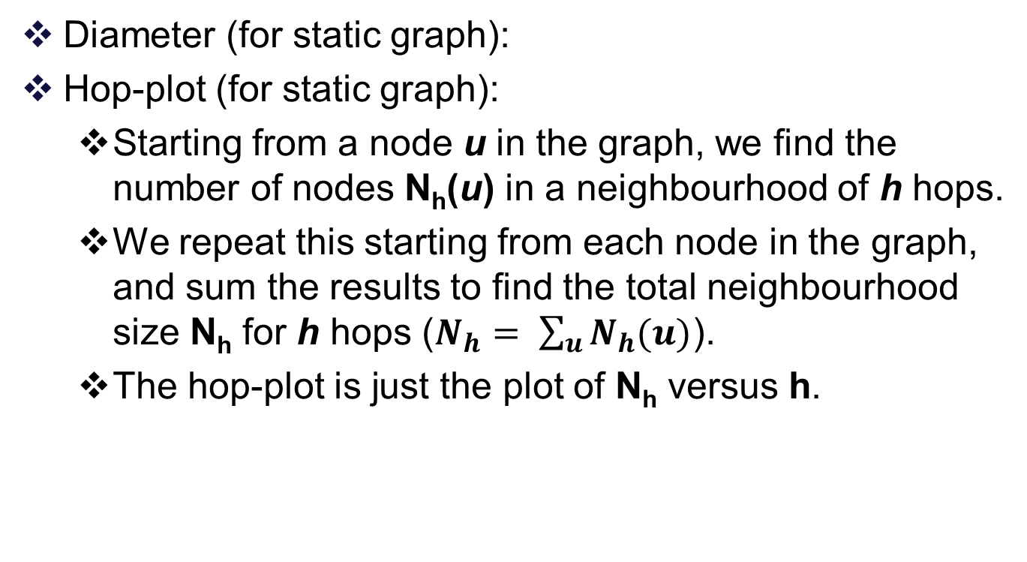
DIAMETER
Diameter (for static graph):
Hop-plot (for static graph):
  Starting from a node u in the graph, we find the number of nodes N_{h}(u) in a neighbourhood of h hops.
  We repeat this starting from each node in the graph, and sum the results to find the total neighbourhood size N_{h} for h hops ($N_{h}= \sum_{u}{N_{h}(u)}$).
  The hop-plot is just the plot of N_{h} versus h.

Slide 15
DIAMETER
Diameter (for static graph):
Hop-plot (for static graph):
Effective diameter or eccentricity (for static graph):
  This is the minimum number of hops in which some fraction (typically 90%) of all connected pairs of nodes can reach each other.

Slide 16
DIAMETER
Diameter (for static graph):
Hop-plot (for static graph):
Effective diameter or eccentricity (for static graph):
Characteristic path length
  For each node in the graph, consider the shortest paths from it to every other node in the graph.
  Take the average length of all these paths.
  Now, consider the average path lengths for all possible starting nodes, and take their median.

Slide 17
DIAMETER
Diameter (for static graph):
Hop-plot (for static graph):
Effective diameter or eccentricity (for static graph):
Characteristic path length
Average diameter:
  This is calculated in the same way as the characteristic path length, except that we take the mean of the average shortest path lengths over all nodes, instead of the median.

Slide 18
DIAMETER
The advantage of eccentricity is :
  its definition works, as is, even for disconnected graphs, whereas we must consider only the largest component for the characteristic and average diameters.
  Characteristic path length and eccentricity are less vulnerable to outliers than average diameter, but average diameter might be the better if we want worst case analysis.

Slide 19
DIAMETER (Examples)
The diameters of several naturally occurring graphs have been calculated, and in almost all cases they are very small compared to the graph size.
Type of Network | Diameter
Internet AS level graph (Autonomous system ) | 4
Router level graph | 12
97%-effective diameter for the Internet Router graph | 15
WWW, when a path exists at all)- directed | 16
WWW, when a path exists at all)- undirected | 7
Facebook social Network | 4
Yahoo web | 7
instant-messenger (IM) network in Microsoft | 7
network of actors | 3.65

Slide 20
Thank You

